Slide 1
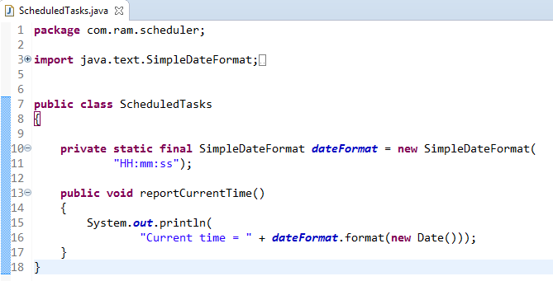
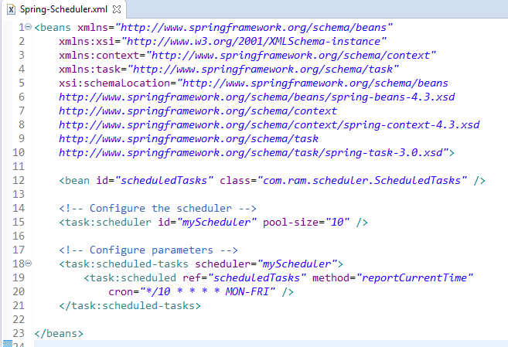
Schedule a Task using Cron Expressions[Configuring scheduled tasks using XML]
Sometimes delays and rates are not enough, and we need the flexibility of a cron expression to control the schedule of our tasks
In this example, that we’re scheduling a task to be executed on Every 10 secs on MON-FRI.

Slide 2
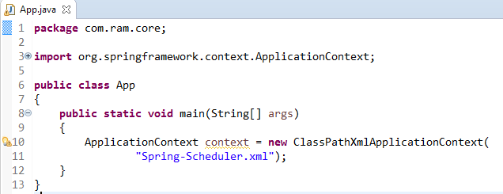
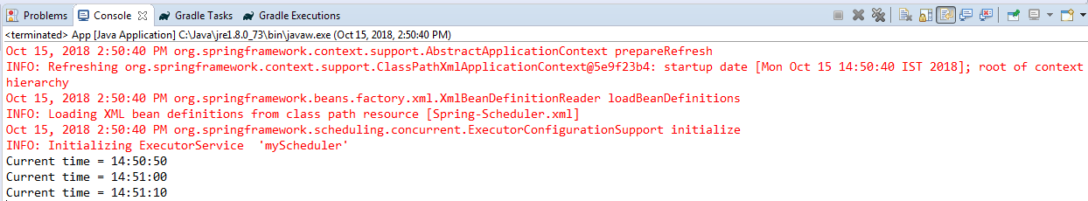
Schedule a Task using Cron Expressions[Configuring scheduled tasks using XML]

Slide 3
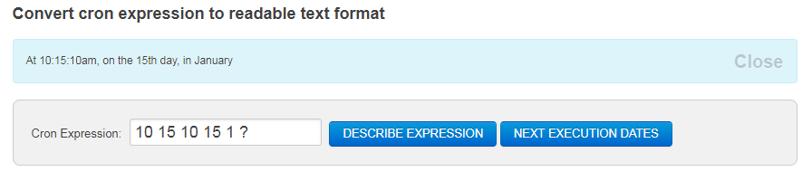
Schedule a Task using Cron Expressions[Configuring scheduled tasks using XML]

Slide 4
Schedule a Task using Cron Expressions[Configuring scheduled tasks using XML]
https://www.freeformatter.com/cron-expression-generator-quartz.html

